Slide 1






THREAT INTELLIGENCE AND THREAT HUNTING
By John Kuria

Slide 2
TABLE OF CONTENTS
What is Cyber Threat Intelligence (CTI)
Target Audience
Threat Actors
CTI Frameworks
CTI Team and Data Sources
Threat Intelligence Tools
Future of CTI and AI
01
02
03
04
05
06
07

Slide 3

DEMYSTIFING CTI
Threat Intelligence
CTI refers to the collection, processing, organizing, and interpreting of data into actionable information or products that relate to capabilities, opportunities, actions and intent of adversaries in the cyber domain to meet a specific requirement determined by and informing decision-makers.

Slide 4

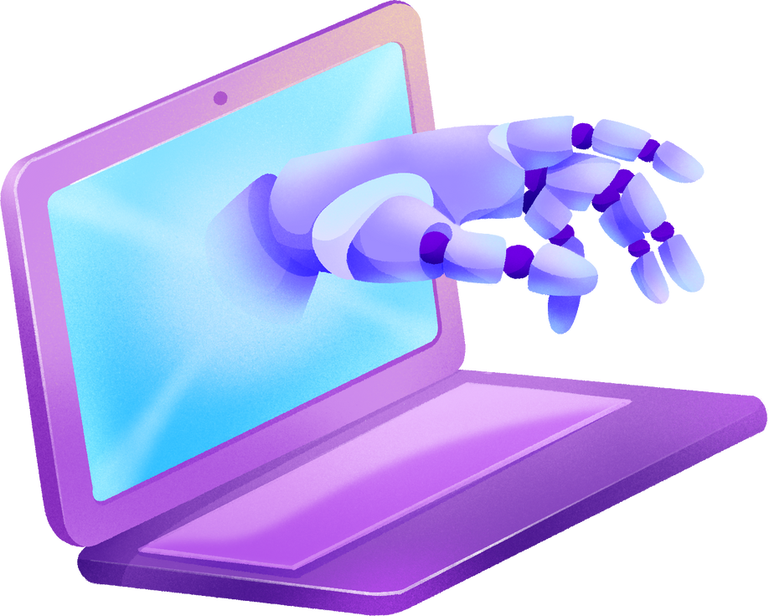
KNOW YOUR AUDIENCE
Strategical
C-SUITE Executives, Decision Makers
Executive Reports
What business units are at most risk to the cyber threat?
Financial risk and cost to the company.
Operational
SSOC Leaders, IT Admins, System Admins, Application Owners
Entities with configuration decisions on control units
Tactical
SOC Analysts (Level 1 and Level 2), people at the forefront of adversary behaviour.
TTPS, IOCs, Modus Operandi

Slide 5

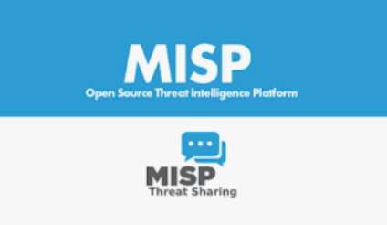
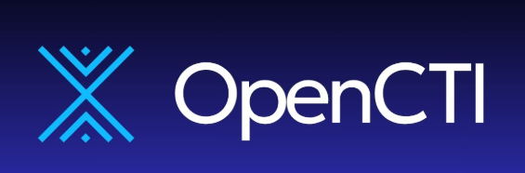


THREAT INTELLIGENCE TOOLS
01
02
03
04
MISP
OPEN CTI
CROWDSTRIKE
DARKTRACE

Slide 6
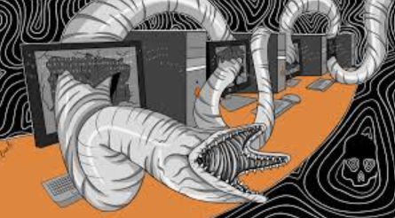



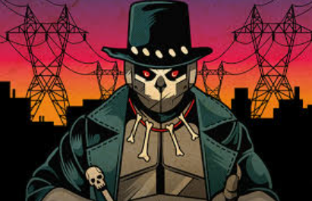

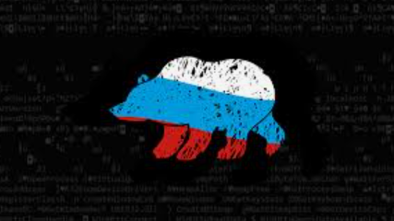



THREAT ACTORS
SANDWORM
COZY BEAR
FANCY BEAR
LOCKBIT
LAZARUS
APT 28
APT 29
FIN 7
ANONYMOUS SUDAN
GREEN MWIZI
VOLT TYPHOON

Slide 7

THE DIAMOND MODEL
ADVERSARY
01
Develops
2. CAPABILITY/TTP
04
02
Exploits
3. VICTIM
03
Connects to
4. INFRASTRUCTURE

Slide 8

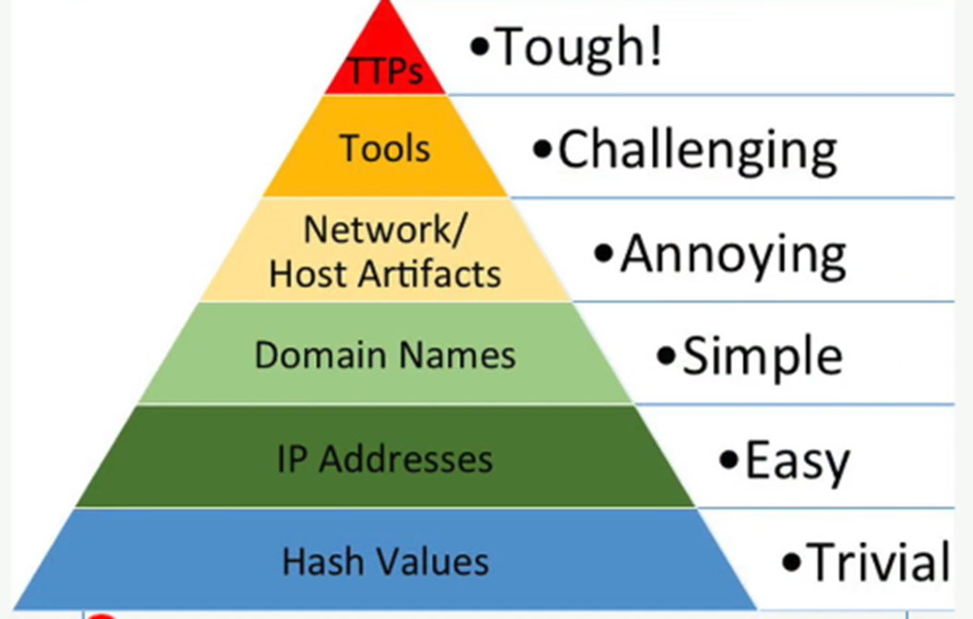

THE PYRAMID OF PAIN
Address the “pain” adversaries have to go through if an element of their TTPS was changed.

Slide 9







DATA SOURCES AND THREAT FEEDS
Virus Total
Alien Vault
Manage Engine
Abuse DB
BrowserLing
01
Mandiant Reports
The Hacker News
Bleeping Computer
SANS Podcast
Dark-web monitoring; channels, discord, twitter, DarkNet Diaries
02

Slide 10
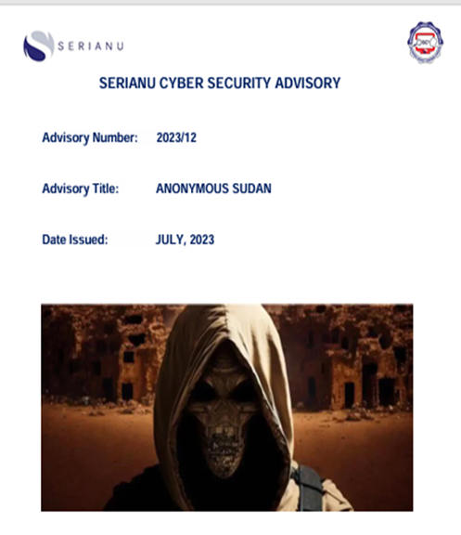
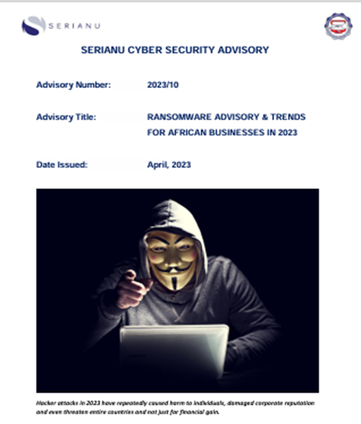
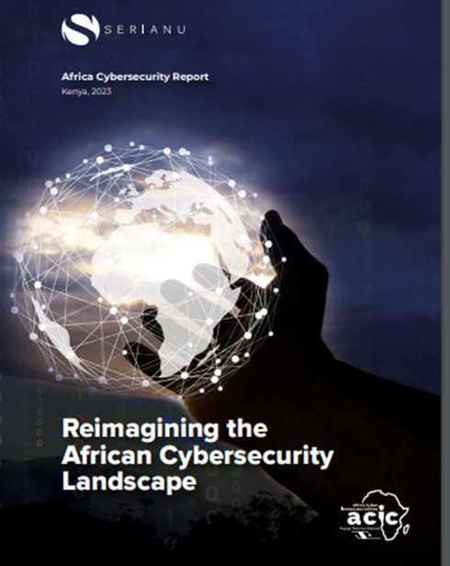
OUTLETS
Blogs
Newsletters

Slide 11
FUTURE OF THREAT INTELLIGENCE...
IN THE ADVENT OF AI

Slide 12


THANK YOU!

